Slide 1
Movie Recommendation Workflow
AI-powered Recommendation System using OpenAI and Vector Stores BY: AANCHAL CHOUDHARY ANSHIKA SINHA

Slide 2
Problem Statement
OTT and movie platforms often recommend based on limited user data.
Users receive generic suggestions instead of personalized recommendations.
Existing systems lack semantic understanding of user preferences.
Need for a smarter, AI-driven recommendation pipeline.

Slide 3
Objective
To build an intelligent movie recommendation workflow.
To use OpenAI embeddings for semantic similarity matching.
To integrate recommendations within a real-time AI chat
interface.
To automate the process using n8n and vector databases.

Slide 4
Proposed Solution
Implement a pipeline combining OpenAI, n8n, and Qdrant vector store.
Process movie data into embeddings for efficient semantic search.
Deliver personalized movie suggestions through an interactive chat UI.
Enable scalability for other domains like music or products.

Slide 5
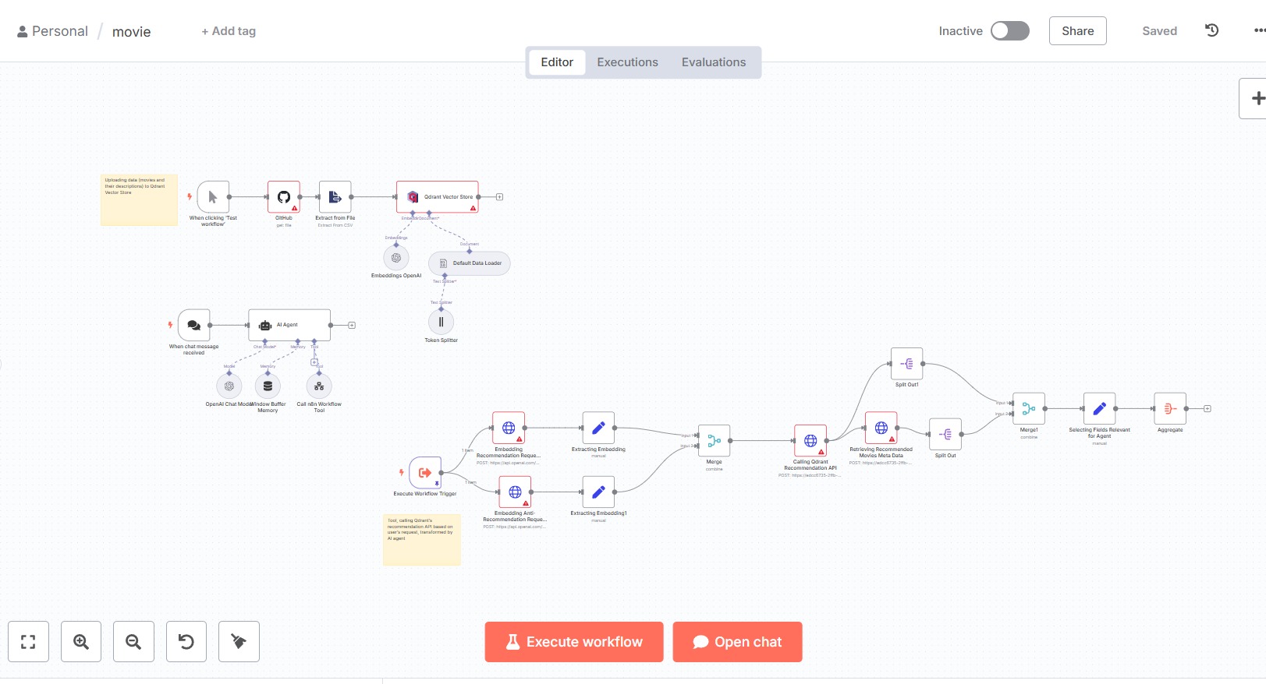
N8N WORKFLOW

Slide 6
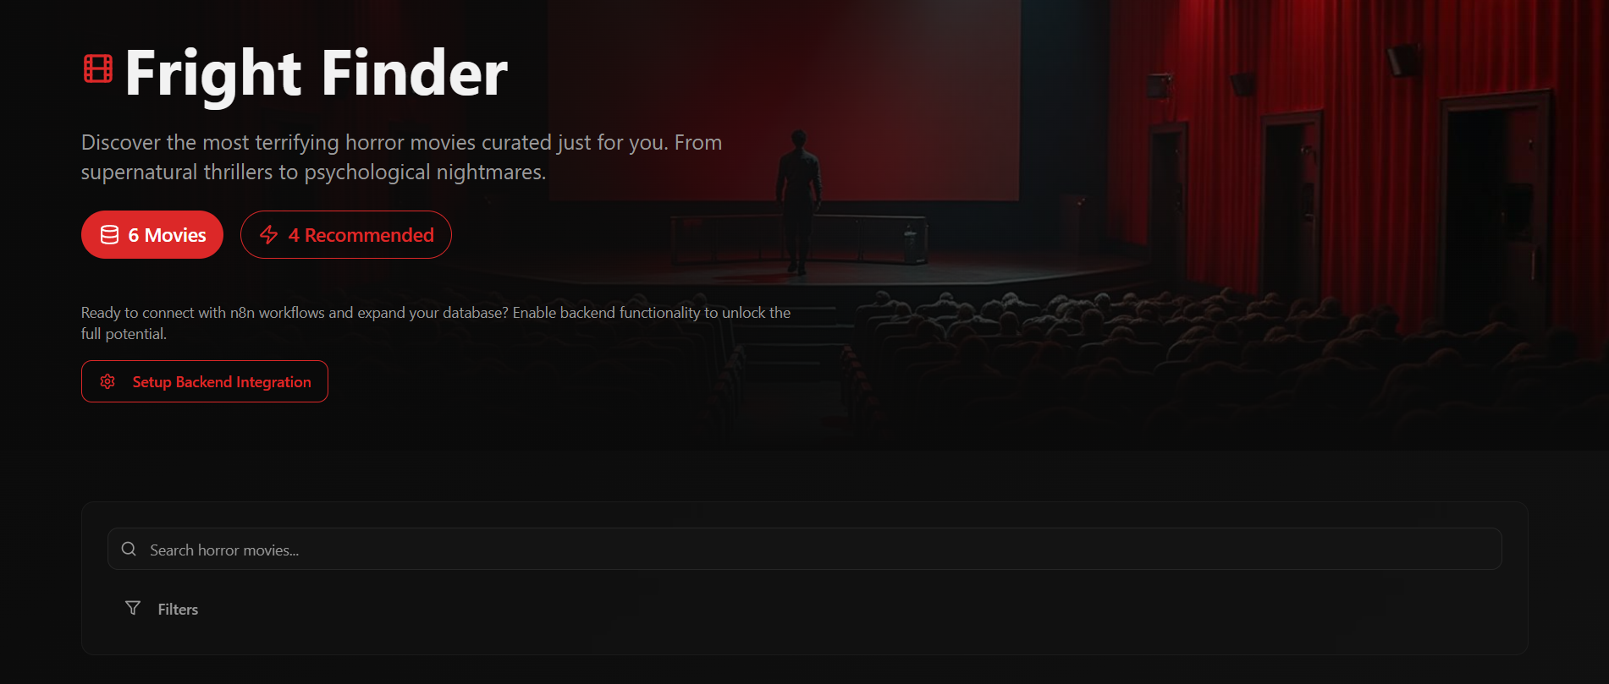
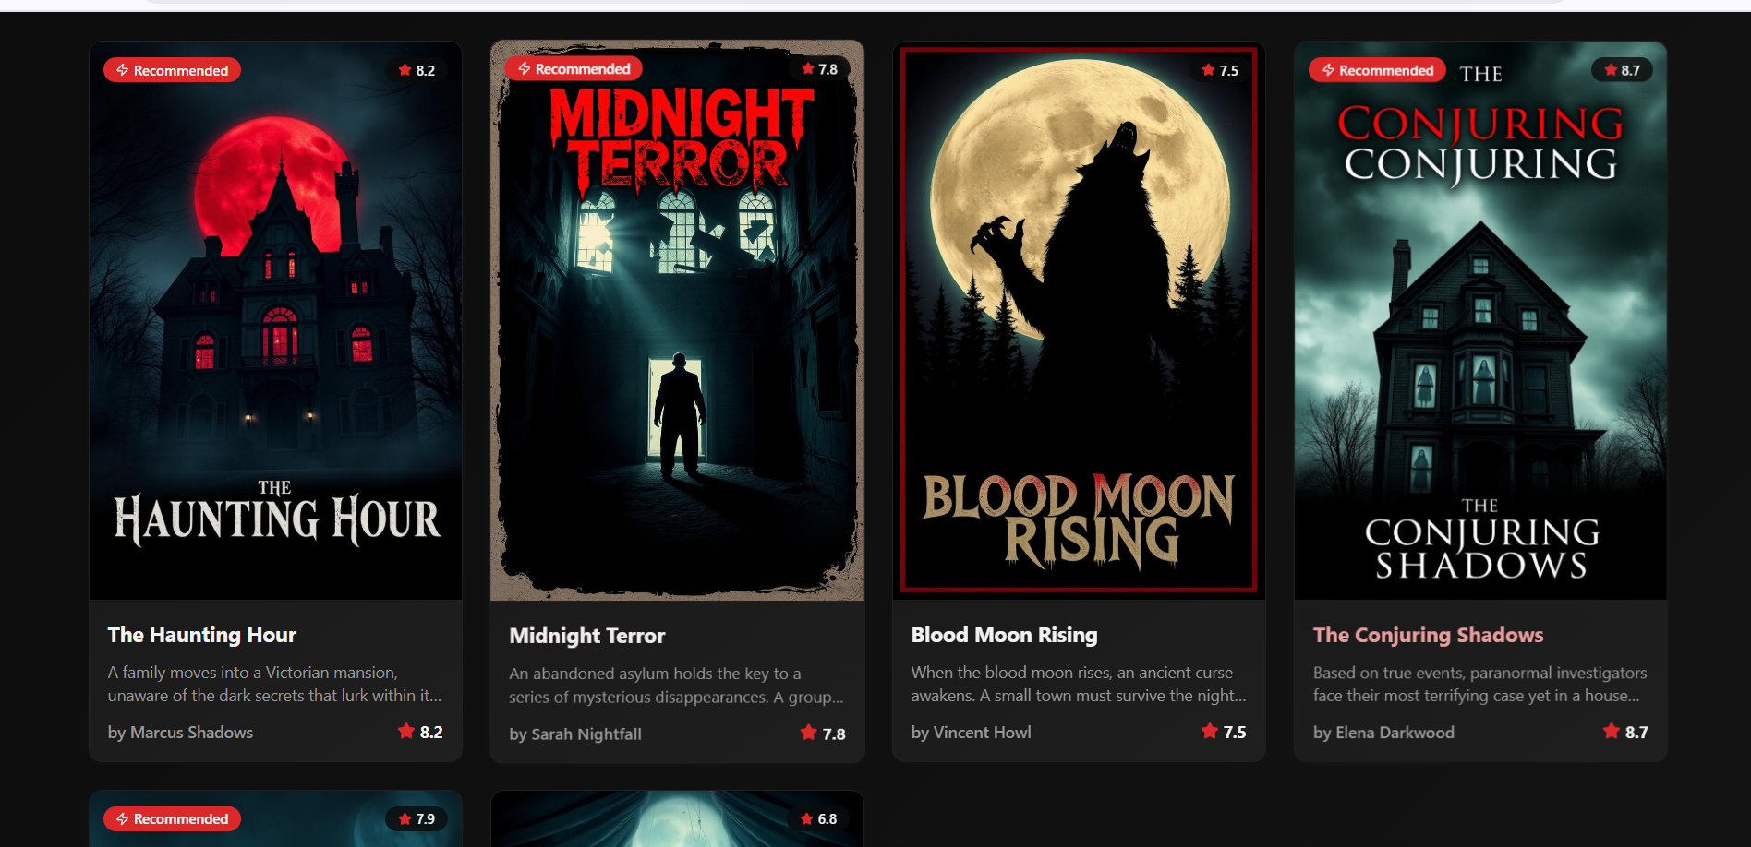
WEBSITE

Slide 7
Key Features
• End-to-end movie recommendation workflow
• Integrates OpenAI embeddings with Qdrant vector store
• Real-time chat interaction with AI Agent
• Personalized movie recommendations with ratings

Slide 8
Conclusion
Built a fully automated, AI-based movie recommender.
Combined OpenAI, n8n, and vector databases seamlessly.
Achieved personalized, semantic-level recommendations.
Future-ready system adaptable to multiple domains.

Slide 9
References / Acknowledgments
OpenAI API Documentation
n8n Workflow Automation
Qdrant Vector Database
Inspiration from real-world recommendation systems
Mentors, guides, or hackathon organizers

Slide 10


